Slide 1
Windows XP/2003
Cody Baker
cody@codybaker.org

Slide 2
Windows XP
Descends from Windows 2000/NT
Also known as Windows NT 5.1
Replaced Win2k and Win9x/ME
  Transparent backwards compatibility
Released October 2001
Service Packs
  SP1 – USB 2.0 & “Program Access & Defaults”
  SP2 – New Security Policies (Improved firewall, NX memory protection, Pop-up blocker, removed Raw socket support), Bluetooth and improved Wifi.

Slide 3
Windows XP Editions
Five Different Editions available in the US
  XP Home
    Limited to 1 CPU, No Windows Domain Support,
  XP Pro
    2 CPUs, Advanced User Policies, Remote Desktop, Encrypted File System,
  XP Media Center Edition
    Pro + TV Support
  XP Tablet PC Edition
    Pro + Handwriting Software
  XP Pro x64
    Compiled for AMD’s Athlon 64 and Intel EM64T Processors.

Slide 4
Windows 2003
Successor to Windows 2000 Server family
  Adds XP Features to Win2K server
  Security Improvements
    Most services disabled by default
    New Security/Performance model for Internet Information Server v6
    Improved Active Directory, Crash Detection, File Snapshot for Backups, Improved Scripting
Service Pack 1 – NX Support & Hot patching.

Slide 5
Windows 2003 Editions
Differences in licensing – Some software enforced.
  Small Business Server – Network Size Limits
  Web Edition – No domain, SQL server, or RAM > 2GB
  Standard Edition – 4GB RAM, 4 CPUS
  Enterprise Edition – 32GB RAM, & Clustering Support
  Datacenter Edition – Between 8 and 64 Processors, 512GB, SAN support. (32-bit limited to 32 procs, and 64GB)
  Storage Server – Headless & SAN support
  Cluster Edition – High performance clustering.

Slide 6
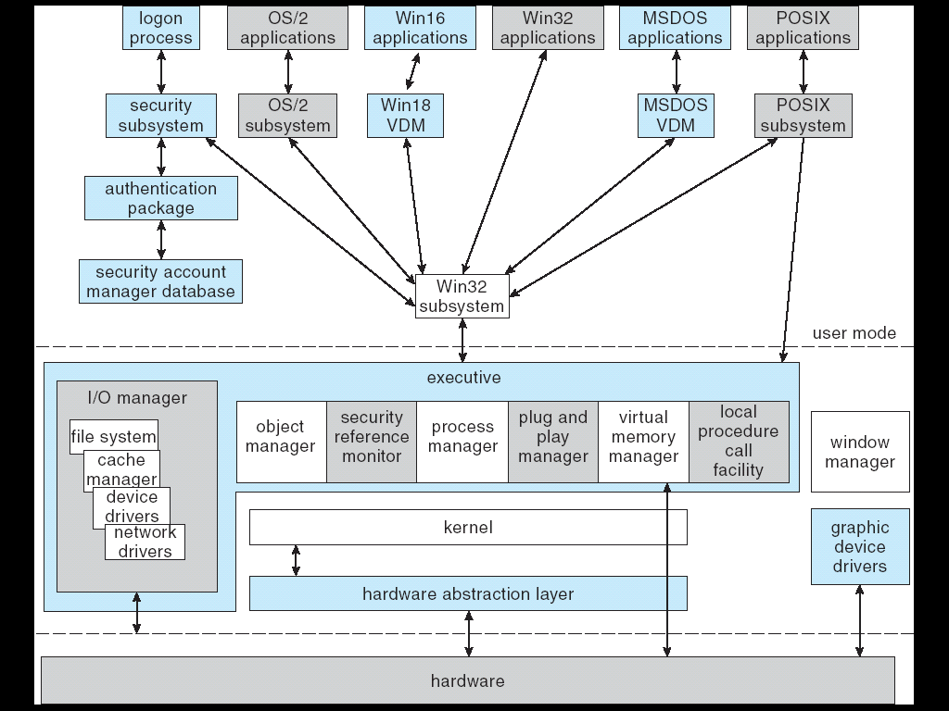
Structure

